Slide 1

Introduction to Tidy Data
Shannon McNee
@ShannonMcNee2

Slide 2

Published Paper
Data Analysis
Notes:
In an ideal world, we would conduct our research, collect our data - whether that be quantitative or qualitative - and then analyse our data using R as our tool.

Slide 3
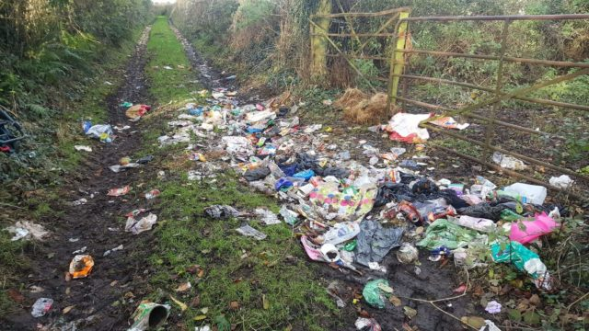
Notes:
But, just like learning and using any language, it's often not that straight forward!
Data can be messy and often times we need to clean it before we can even begin to make any sense of it.
**THEN OPEN UP R AND SHOW EYE DESCRIPTIONS DATASET, TALK THROUGH IT WITH AUDIENCE**

Slide 4
Questions we might ask ourselves
How can I organise this data?
How can I make this data meaningful?
How can I make this data tidy?
And maybe even more importantly…
Why should I even bother with tidying my data?
Notes:
Being faced with messy data can be overwhelming and you may be asking yourself questions like:
* How can I organise this data?
* How can I make this data meaningful?
* How can I make this data TIDY?
* Why should I bother?
Some have estimated that 80% of data analysis is actually spent on data preparation (Dasu & Johnson, 2003), getting your data into a usable format before you even think about analysing it. Many people spend days, weeks, and even months labouring over data cleaning in Excel which involves numerous point and click repetitions. This isn't only stressful for you as a researcher, but it's an inefficient use of time and resources which could in turn impact on your own productivity but also the productivity of your lab or research group.
The way to get over this hurdle is through developing skills in **DATA WRANGLING**.
One of the amazing things about R being open source and available to all is that **ANYONE** can write code, functions, and packages and make them freely available to all.
That's great news for us because this crowdsourcing approach to coding has given us the Tidyverse

Slide 5
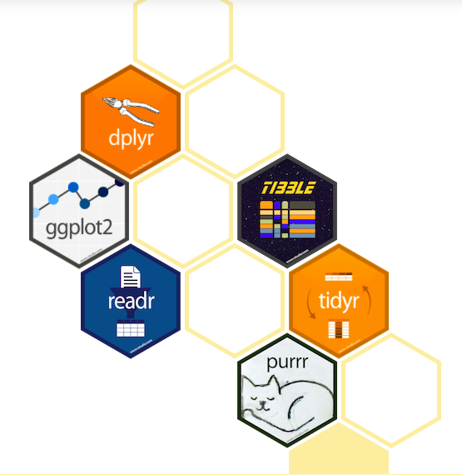
Notes:
The Tidyverse is a collection of R packages with a common design philosophy, grammar, and data structure that makes analysis faster, easier, and fun.
One of the key underlying structures of the tidyverse is that data structures follow a tidy format:
1. Each variable is in a column
2. Each observation is a row
3. Each value is a cell
If you make sure your data is tidy, you'll spend less time rummaging through rubbish on your research path and spend more time working on your all important analysis!

Slide 6
The Wickham Six
90% of data analysis can be reduced to these six English verbs:
select
filter
mutate
arrange
group_by
summarise
In addition:
gather
spread
separate
Notes:
Go through each verb one by one just quickly describing what they do. Will be going through each verb in turn using the dataset.

Slide 7
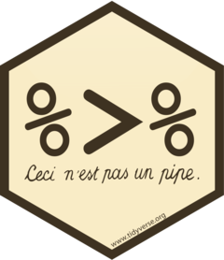
Telling a story through code
= “and then”
Notes:
Notice that we started off with a variable called eye_data, and then it became gathered_eyes,and then separated_eyes, and then filtered_eyes and so on.
Even though all of the steps we just carried out are important - it is key to point out that these are intermediate steps that get us from our messy original dataset to our clean, tidy, top 10. It would be much nicer not to have to do all of this record keeping, and it would make the code much more readable and powerful.
Just like in spoken and written language, our verbs can be tied together to tell a story.
The pipe operator %>% can be read in English as "and then". This operator allows us to string functions together to form a single, powerful pipeline.

Slide 8
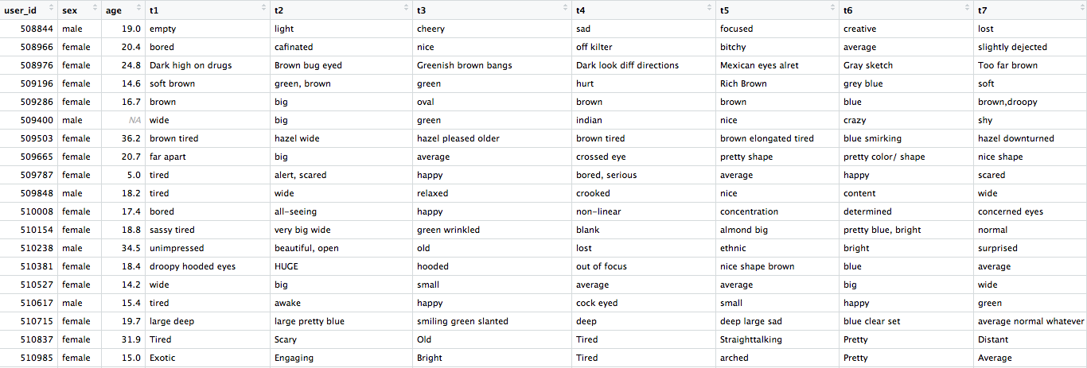
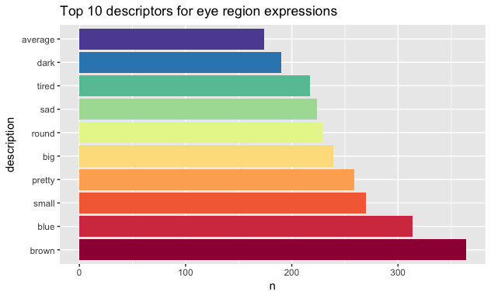
Notes:
Through using powerful tools within the Tidyverse we have been able to tidy our messy dataset in order to create a clear, accessible visualisation which provides us with interesting information about our data. Data cleaning doesn’t have to be time consuming and stressful - with the right tools, you are more than capable of hacking your data tidy which has a range of benefits for your productivity, your stress levels, and your ability to communicate your research clearly and effectively.

Slide 9
Thank you for listening!

